Slide 1
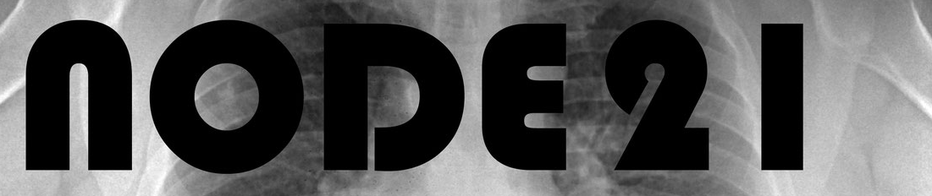
Chest Nodule Generation
Abu_Shahid(B20CS003) Atharva_Pandey(B20CS007)

Slide 2
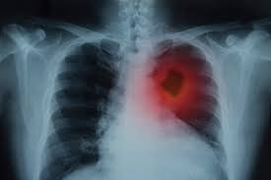
Why? need?
Lung cancer is the leading cause of cancer deaths globally in both men and women.

Slide 3
Why? need?
Lung cancer is the leading cause of cancer deaths globally in both men and women.
Symptoms of lung cancer often appear in later stages, reducing the effectiveness of treatment.

Slide 4
Why? need?
Lung cancer is the leading cause of cancer deaths globally in both men and women.
Symptoms of lung cancer often appear in later stages, reducing the effectiveness of treatment.
Early detection is crucial for lowering mortality rates.

Slide 5
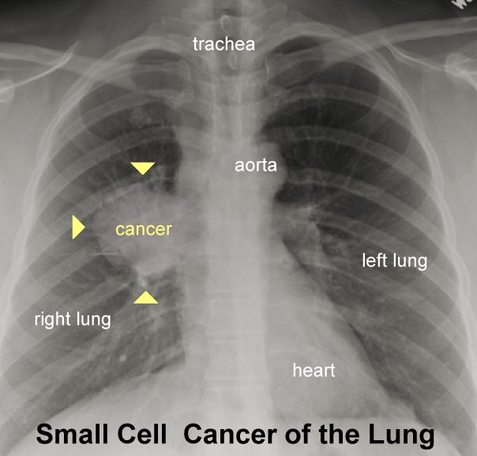
Why? need?
Pulmonary nodules are the first signs of lung cancer, often visible before symptoms appear.

Slide 6
Why? need?
Pulmonary nodules are the first signs of lung cancer, often visible before symptoms appear.
Chest radiography (CXR) is the most common imaging method globally.

Slide 7
Why? need?
Pulmonary nodules are the first signs of lung cancer, often visible before symptoms appear.
Chest radiography (CXR) is the most common imaging method globally.
Pulmonary nodules are commonly found incidentally during routine examinations or CXR imaging for other health concerns.

Slide 8
Difficulty
Detecting lung nodules on CXR can be challenging due to factors such as size, density, and location.

Slide 9
Difficulty
Detecting lung nodules on CXR can be challenging due to factors such as size, density, and location.
Projection images in CXR can cause nodules to overlap with other anatomical structures like the heart, hilum, or diaphragm.

Slide 10
Difficulty
Detecting lung nodules on CXR can be challenging due to factors such as size, density, and location.
Projection images in CXR can cause nodules to overlap with other anatomical structures like the heart, hilum, or diaphragm.
This overlap can make nodules difficult to discern and potentially impossible to detect.

Slide 11
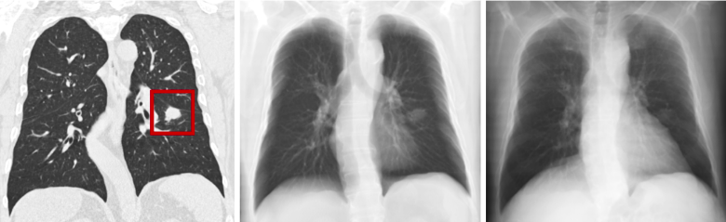
BIggest Underlying issue??
Lack of data

Slide 12
BIggest Underlying issue??
Lack of data
Uneconomical costs of annotating such a data

Slide 13
NODE21 public CXR training dataset
It contains 4882 frontal chest radiographs.

Slide 14
NODE21 public CXR training dataset
It contains 4882 frontal chest radiographs.
1134 images are annotated with bounding boxes around nodules, totaling 1476 nodules.

Slide 15
NODE21 public CXR training dataset
It contains 4882 frontal chest radiographs.
1134 images are annotated with bounding boxes around nodules, totaling 1476 nodules.
3748 images represent the negative class, as they do not contain nodules.

Slide 16
NODE21 public CXR training dataset
It contains 4882 frontal chest radiographs.
1134 images are annotated with bounding boxes around nodules, totaling 1476 nodules.
3748 images represent the negative class, as they do not contain nodules.
Nodules should be generated for each CXR image marked with label==0, indicating the absence of nodules.

Slide 17
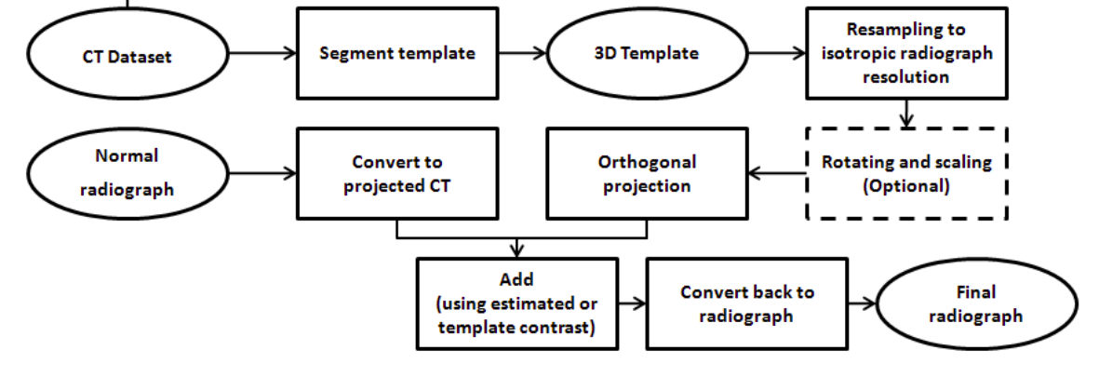
Approach 0:node21_generation_baseline

Slide 18
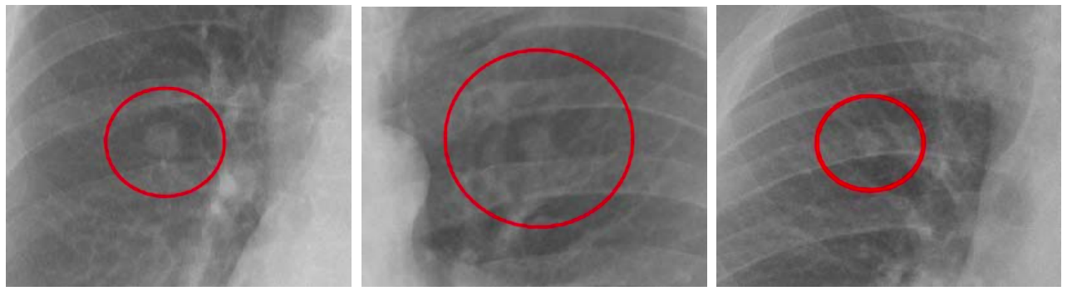
Approach 0:node21_generation_baseline: results

Slide 19
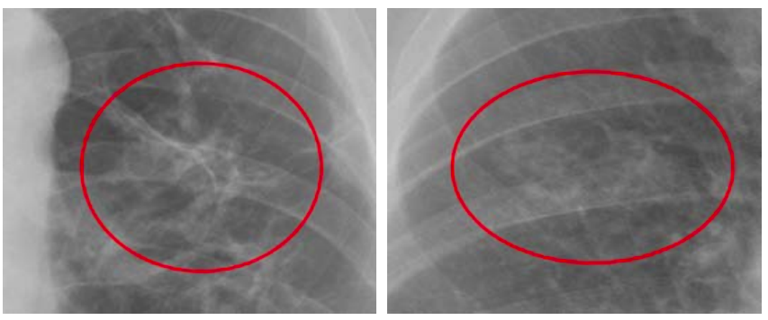
Approach 0:node21_generation_baseline: results

Slide 20
Approach 1: Eigen Nodules
Extract nodules from dataset, resize to 64*64, and store

Slide 21
Approach 1: Eigen Nodules
Extract nodules from dataset, resize to 64*64, and store
Extract vector subspace from the images and create a convex hull parameterized eigenvectors

Slide 22
Approach 1: Eigen Nodules
Extract nodules from dataset, resize to 64*64, and store
Extract vector subspace from the images and create a convex hull parameterized eigenvectors
Randomly sample vectors from the hull and reshape to 64*64 for nodule reconstruction

Slide 23
Approach 1: Eigen Nodules
Extract nodules from dataset, resize to 64*64, and store
Extract vector subspace from the images and create a convex hull parameterized eigenvectors
Randomly sample vectors from the hull and reshape to 64*64 for nodule reconstruction
Use Gaussian mixture model to create a region proposal network

Slide 24
Approach 1: Eigen Nodules
Extract nodules from dataset, resize to 64*64, and store
Extract vector subspace from the images and create a convex hull parameterized eigenvectors
Randomly sample vectors from the hull and reshape to 64*64 for nodule reconstruction
Use Gaussian mixture model to create a region proposal network
Blend the generated nodule on a CT scan image using a Gaussian mask

Slide 25
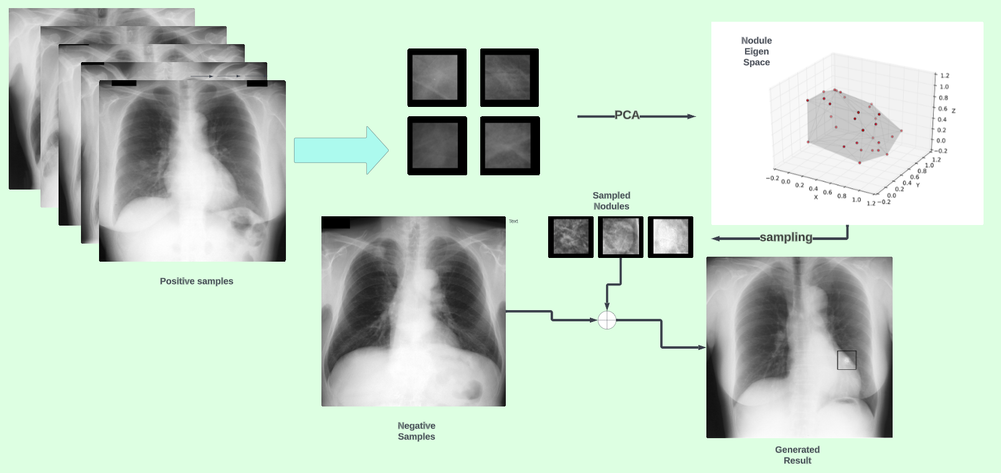
Approach 1: Eigen Nodules

Slide 26
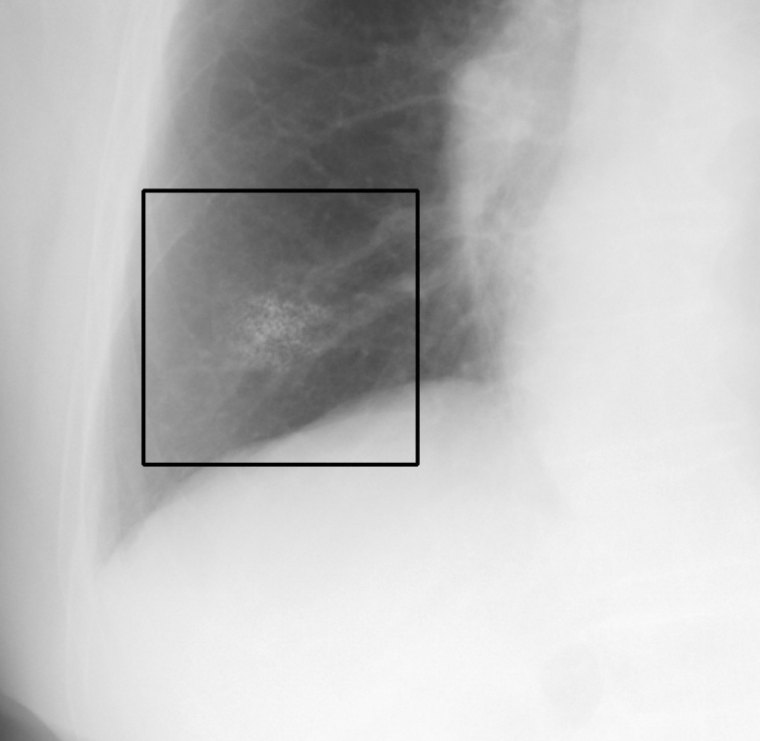
Approach 1: Eigen Nodules; results

Slide 27
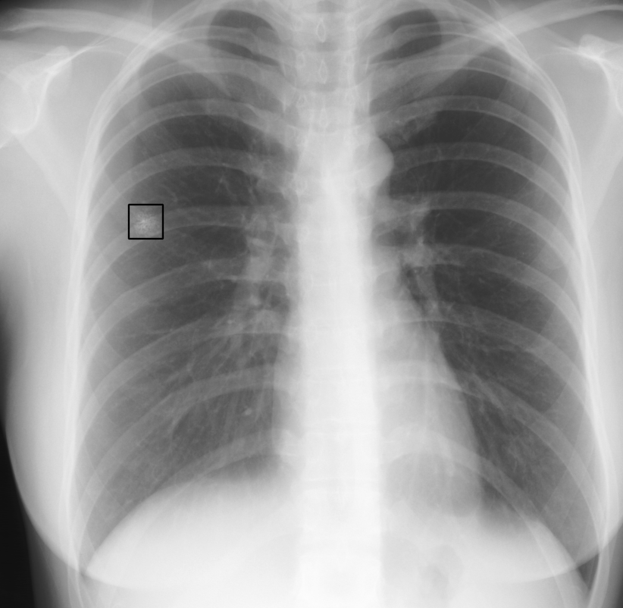
Approach 1: Eigen Nodules; results

Slide 28
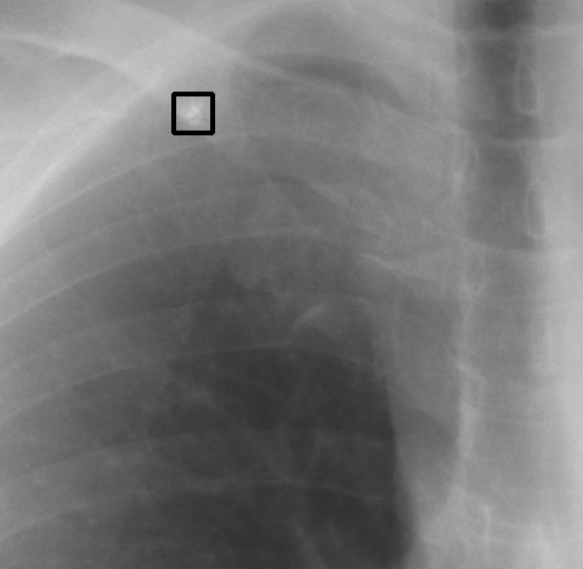
Approach 1: Eigen Nodules; results

Slide 29
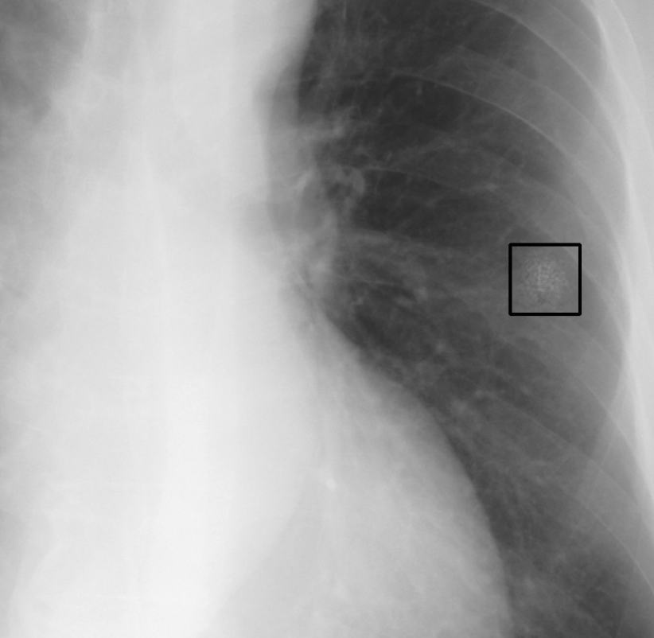
Approach 1: Eigen Nodules; results

Slide 30
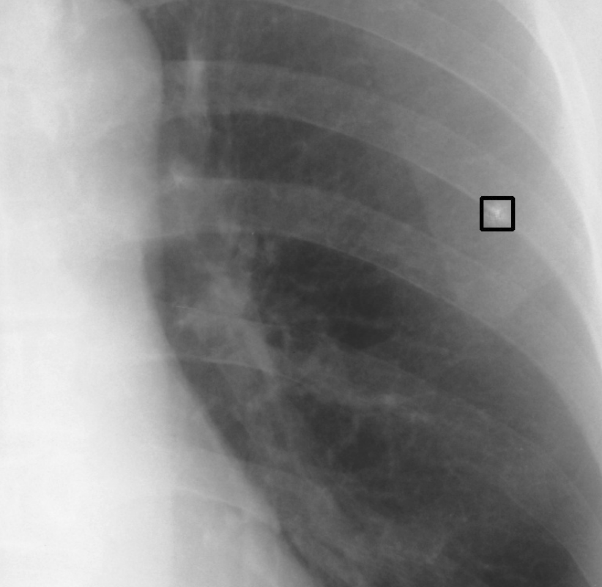
Approach 1: Eigen Nodules; results

Slide 31
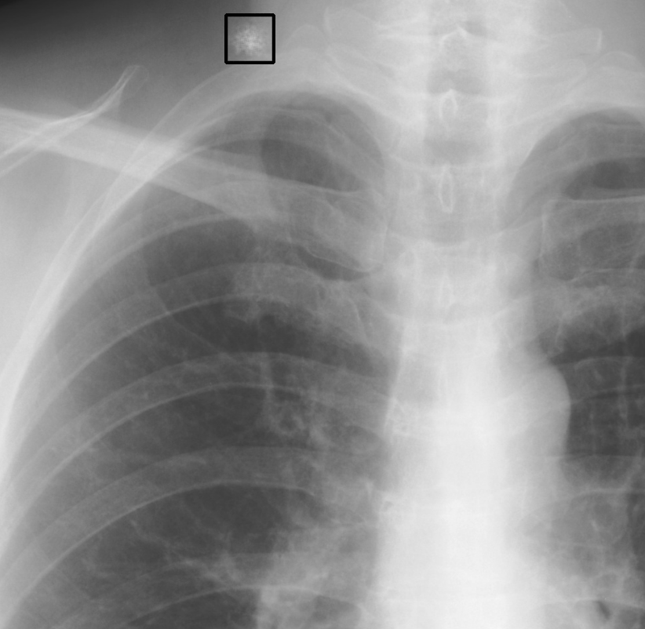
Approach 1: Eigen Nodules; FLAWS
Generated nodule may not always lie in the lung region.
Eigenvectors may not form a convex hull
Nodule generated on bone; cannot be differentiated
Nodules of small size
Node generated outside the lung

Slide 32
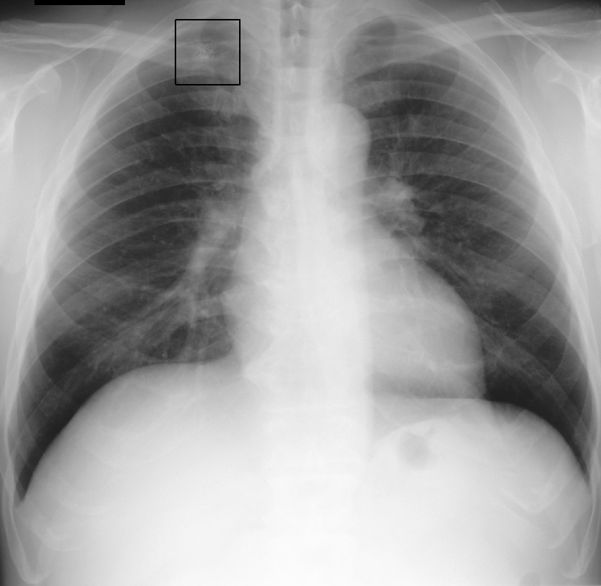
Approach 1: Eigen Nodules; FLAWS
Generated nodule may not always lie in the lung region.
Eigenvectors may not form a convex hull
Nodule generated on bone; cannot be differentiated
Nodules of small size
Nodule generated on the bone

Slide 33
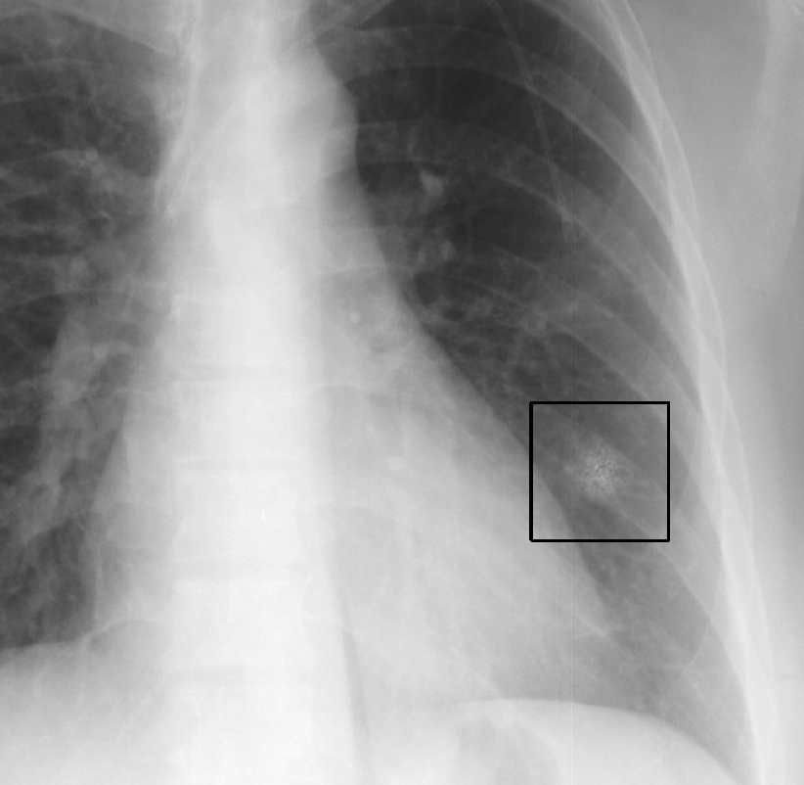
Approach 1.2: Eigen Nodules w/ Clahe;
Extracted nodule patches are enhanced using CLAHE before PCA

Slide 34
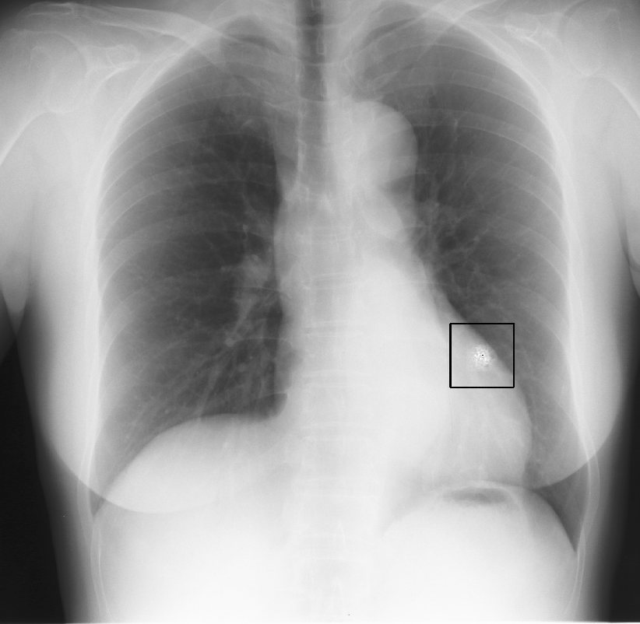
Approach 1.2: Eigen Nodules w/ Clahe;
Extracted nodule patches are enhanced using CLAHE before PCA

Slide 35
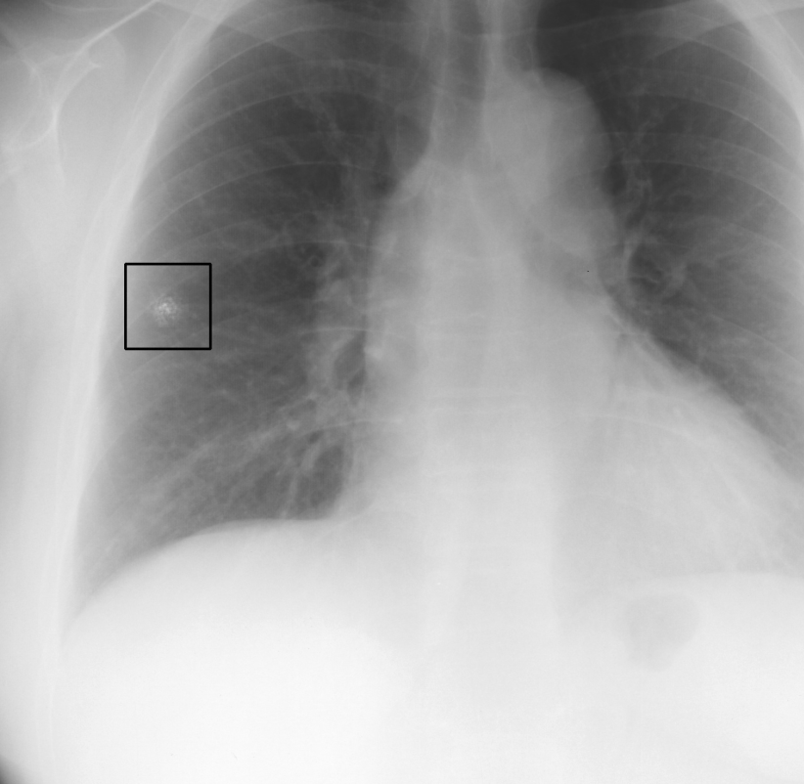
Approach 1.2: Eigen Nodules w/ Clahe;
Extracted nodule patches are enhanced using CLAHE before PCA

Slide 36
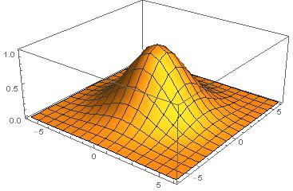
How was blending done?
Gaussian mask
Local intensity informed alpha blending

Slide 37
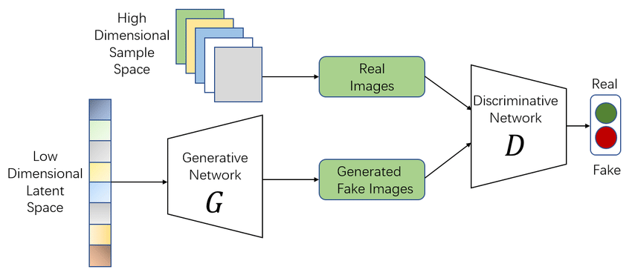
Approach 2: GANS
The generator network synthesizes chest X-ray images with nodules, attempting to mimic real data,
Discriminator evaluates these generated images against authentic ones.
This adversarial process refines the generator's ability to produce realistic images.
GANs contribute to data augmentation strategies by generating diverse X-ray images
Figure illustrating GANs

Slide 38
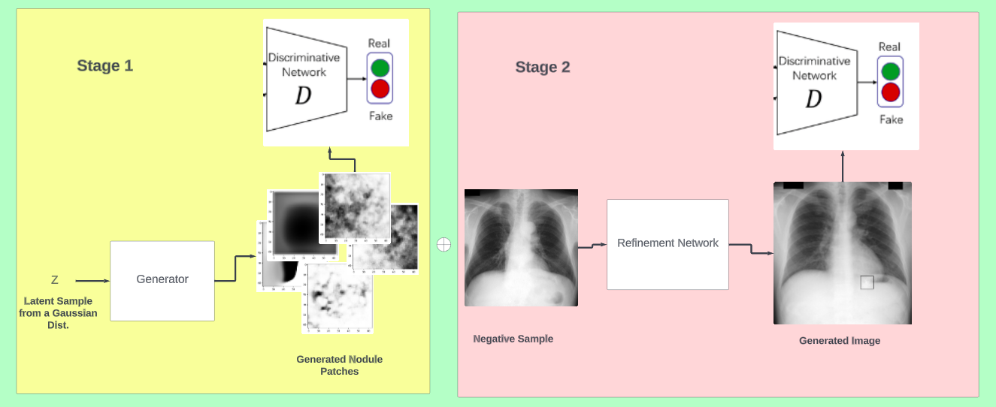
Approach 2: GANS
Modelled distribution of nodules
Once we have a nodule generated, overlaid it on CXR by regressing location, size
Decided to blend nodule using another refinement network.
Proposed an RPN
Our Pipeline

Slide 39
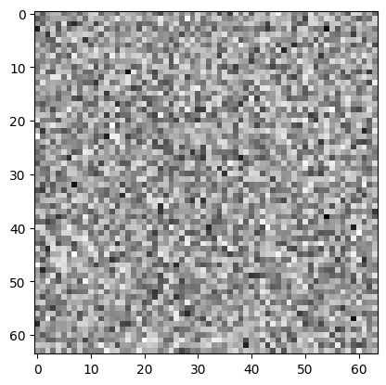
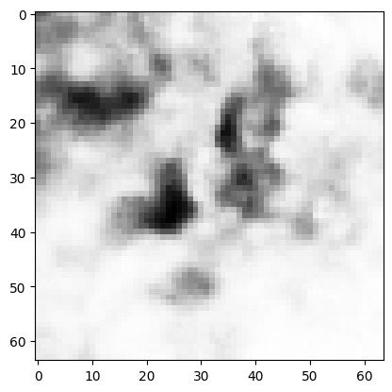
Approach 2.1: Stage 1; training
ANN based generator
Noisy generation
Unable to capture pattern generation
Solution?
Gradient Minimization loss included;
before
after

Slide 40
Approach 2.1: Stage 1; training
ANN based generator
Noisy generation
Unable to capture pattern generation
Solution?
Gradient Minimization loss included; can give even better results
before
after

Slide 41
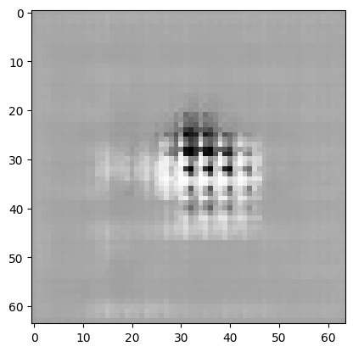
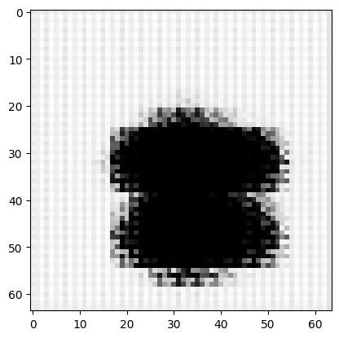
Approach 2.2: Stage 1; training
Result still noisy; only diffused structures captured
Solution?
Transpose Convolutional based generator
Issue*
Checked artefacts

Slide 42
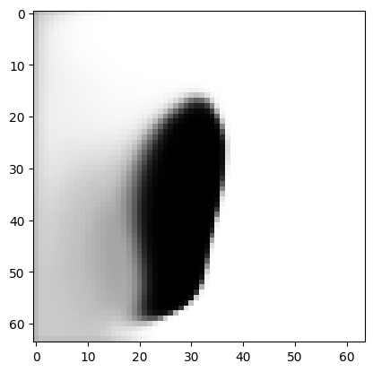
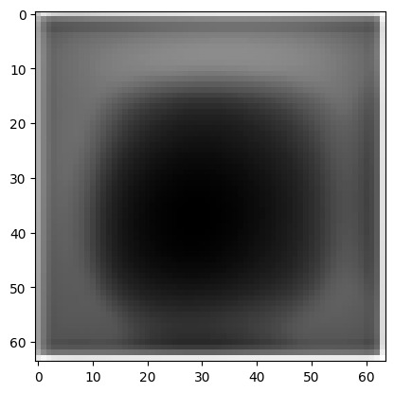
Approach 2.3: Stage 1; training
Solution?
Replace Transpose Convolutional based generator w/ Upsampling & convolution layer
Bilinear interpolation used for upsampling
Issues*
Learned noises too smooth
Diffused patterns not learned

Slide 43
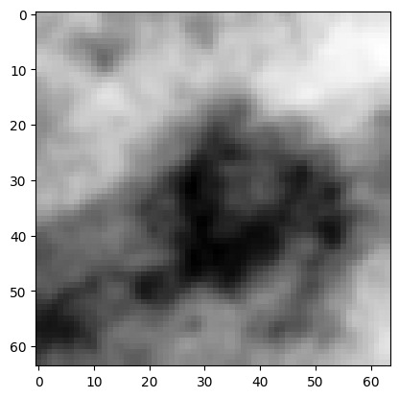
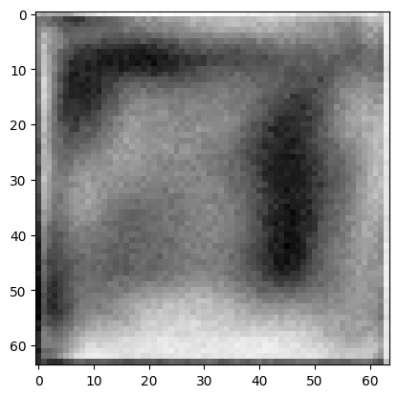
Approach 2.4: Stage 1; training
Solution?
Weighted average of both the generators in v2.1&v2.3
Domain knowledge needed for further explainability
All the approaches were trained in GAN setup

Slide 44
Approach 2.4: Stage 2; training
Refinement network for blending
Nodule patch generated was reshaped using size regressed via Gaussian Mixture Model
Patch & Neg. sample sent via 2 channels into a shallow CNN, trained in GAN setup

Slide 45
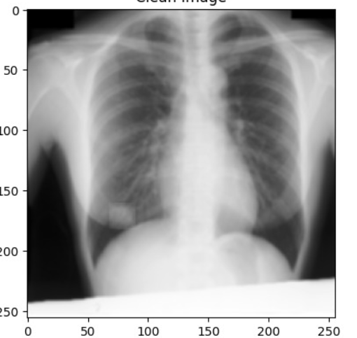
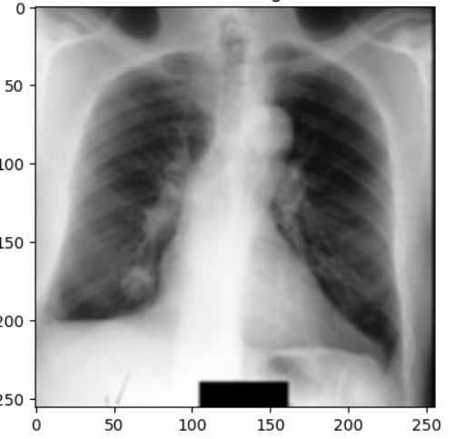
Approach 2.4: Results
Without refinement
With refinement

Slide 46
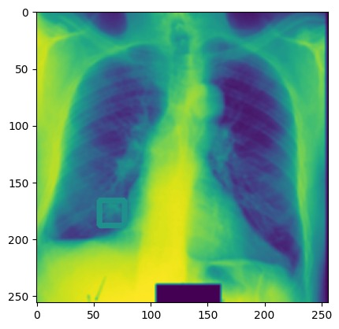
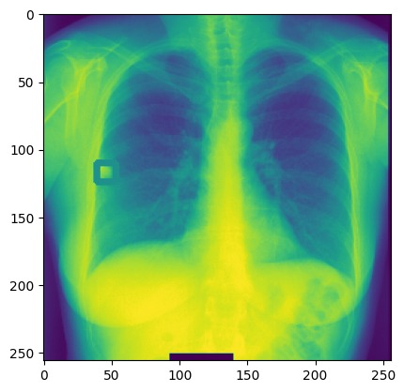
Approach 2.4: Results

Slide 47
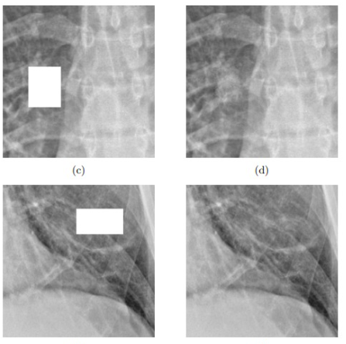
Vs SOTA

Slide 48
Related works;
Attempted bone suppression to extract better nodules for Eigen-nodules
Outdated repo; could not make work
Disentanglement for CXR
Was trained on MNIST; no pretrained model
Was taking huge compute, time to get trained
Ideas that could not come to fruition
CRFill- wanted to tinker around
Diffusion Models- Compute issues

Slide 49
Thank you :)

